Slide 1
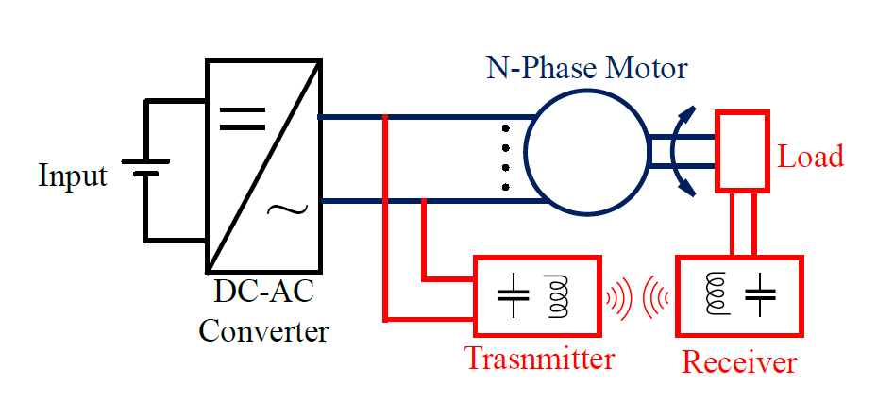
Wireless Power Transfer Embedded in motor drives for contactless slip ring applications

Slide 2
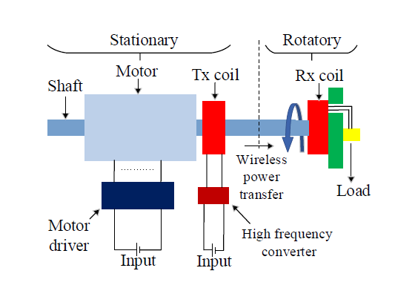
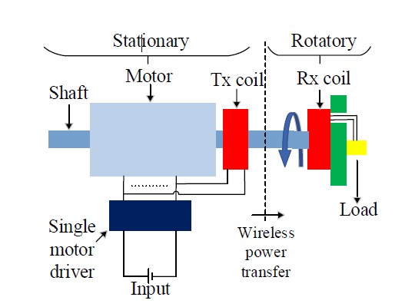
Advantages
Aa
Aaa
Aaa
Aaa
aaa
Trade-offs
Aa
Aaa
Aaa
Aaa
aaa

Slide 3
Literature
Simultaneous
power transfer
Selective
Power Transfer
Slip-Ring Applications
Single-Stage
Power Transfers
Simultaneous Wireless Information and Power Transfer (SWIPT): Recent Advances and Future Challenges (2018)
Integrated Resonant Structure for Simultaneous Wireless Power Transfer and Data Telemetry(2012)
A Generalized Methodology to Generate, Amplify and Compensate Multi-Frequency Power for a Single-Inverter-Based MF-MR-S-WPT System(2020)
A Simultaneous Wireless Power and Data Transmission Method for Multi-Output WPT Systems: Analysis, Design, and Experimental Verification (2020)
Single-Inductor Multiple-Output (SIMO) Buck Hybrid Converter for Simultaneous Wireless and Wired Power Transfer(2020)
Cross Interference Minimization and Simultaneous Wireless Power Transfer to Multiple Frequency Loads Using Frequency Bifurcation Approach(2019)
Selective Omnidirectional Magnetic Resonant Coupling Wireless Power Transfer With Multiple-Receiver System(2018)
Design and Analysis of Wireless Switched Reluctance Motor Drives(2019)
Frequency Splitting-Based Wireless Power Transfer and Simultaneous Propulsion Generation to Multiple Micro-Robots(2018)
Comparative Analysis of Frequency-Selective Wireless Power Transfer for Multiple-Rx Systems(2020)
A Frequency-Selective EMI Reduction Method for Tightly Coupled Wireless Power Transfer Systems Using Resonant Frequency Control of a Shielding Coil in Smartphone Application(2020)
Selective Wireless Power Transfer for Smart Power Distribution in a Miniature-Sized Multiple-Receiver System(2016)
A Multifrequency Superposition Methodology to Achieve High Efficiency and Targeted Power Distribution for a Multiload MCRWPT System(2018)
Cross Interference Minimization and Simultaneous Wireless Power Transfer to Multiple Frequency Loads Using Frequency Bifurcation Approach
A Primary-Side Control Method of Wireless Power Transfer for Motor Electric Excitation(2019)
Wireless DC Motor Drives with Selectability and Controllability(2017)
An Airborne Radar Power Supply With Contactless Transfer of Energy—Part I: Rotating Transformer (2007)
Aerodynamic Fluid Bearings for Translational and Rotating Capacitors in Noncontact Capacitive Power Transfer Systems(2014)
Synchronous Generator Brushless Field Excitation and Voltage Regulation via Capacitive Coupling Through Journal Bearings(2017)
Operation of an Electrical Excited Synchronous Machine by Contactless Energy Transfer to the Rotor(2018)
A Rotation-Lightweight Wireless Power Transfer System for Solar Wing Driving(2019)
Wireless Power Transfer for Smart Industrial and Home Applications(2019)
A High-Efficiency GaN-Based Single-Stage 6.78 MHz Transmitter for Wireless Power Transfer Applications(2019)
Cooperative Integration of RF Energy Harvesting and Dedicated WPT for Wireless Sensor Networks(2019)
A Three-Phase Single-Stage AC–DC Wireless-Power-Transfer Converter With Power Factor Correction and Bus Voltage Control(2020)
Individually Regulated Multiple-Output WPT System With a Single PWM and Single Transformer (2020)
Look at Mendeley : PowerLab/Enes/WPT-Motor

